Slide 1




ISWC2014 Tutorial on Large Scale Reasoning Over Semantic Data
Presenters:
Jeff Z. Pan (University of Aberdeen)
Raghava Mutharaju (Wright State University)
Ilias Tachmazidis (University of Huddersfield)
Guilin Qi (Southeast University)

Slide 2
Agenda
9:10am – 9:45am
Motivations and Overview of Background Knowledge (Jeff, Ilias)
9:45am – 10:30am
Scalable OWL 2 DL reasoning based on approximation and divide-and-conquer approaches (Jeff)
10:30am – 11:00am
Coffee break
11:00am – 11:45am
Distributed Reasoning in OWL 2 EL (Raghava)
11:45am – 12:30pm
Large Scale Non-Monotonic Reasoning (Ilias)

Slide 3
Agenda
2:00pm – 2:45pm
Scalable RDFS Reasoning Using MapReduce (Raghava)
2:45pm – 3:30pm
Applications (Raghava, Jeff)
3:30pm – 4:00pm
Coffee break
4:00pm – 4:45pm
Lesson Learned and Conclusions (Jeff, Raghava)

Slide 4

Session Agenda
Motivation
MapReduce paradigm
Defeasible Logic
Well-Founded Semantics
Future Directions

Slide 5
Motivation: The Challenge of Big Data
Big Data: Huge data sets coming from
the Web, sensor networks, social media, etc.
Applications: e.g. smart cities, intelligent environments, information extraction
The challenge:
Scaling up to big data is not trivial
New approaches, new algorithms

Slide 6
Motivation: Opportunities of Big Data
Opportunities for Knowledge Representation
Decision making
Decision support
Data cleaning
Inferring high-level knowledge from low-level input

Slide 7
Big Data: Challenge for Reasoning
Big Data: significant computational challenges
Focus on rich knowledge representation structures
But: scalability of reasoning?
Efficient reasoning in combination with huge amounts of data?
Centralized in-memory solutions do not scale to the Big Data challenge
Billions of facts result in over 20GB of data
But this is the traditional KR approach

Slide 8
Related Work
Parallelization approaches:
Rule decomposition
Data decomposition
Allows efficient reasoning on large data sets
100 billion triples
Datalog (e.g. Afrati & Ullmann)
RDF/S (e.g. Weaver & Hendler)
OWL-Horst (e.g. Urbani et al.)

Slide 9
Novel Contribution (1/2)
All previous works: consistent sets of rules
In practice big data is messy and inconsistent
Nonmonotonic reasoning, supports
dealing with inconsistencies
dealing with deficient (sensor) data
reasoning with missing (incomplete) information

Slide 10
Novel Contribution (2/2)
Defeasible reasoning
Can resolve inconsistencies due to imperfect data
Well-Founded Semantics
Can handle the absence of information
Apply MapReduce paradigm to nonmonotonic reasoning

Slide 11
MapReduce Paradigm
Inspired by similar primitives in LISP and other functional languages
Operates exclusively on <key, value> pairs
MapReduce job:
Map(input) → <k1,v1>, <k2,v2>, <k1,v3>
Grouping/sorting → <k1,<v1,v3>>, <k2,<v2>>
Reduce(k1,<v1,v3>) → output
Reduce(k2,<v2>) → output

Slide 12
MapReduce Framework
Provides an infrastructure that takes care of
distribution of data
management of fault tolerance
results collection
For a specific problem
developer writes a few routines which are following the general interface

Slide 13
Defeasible Logic (1/2)
Facts
e.g. bird(eagle)
Strict Rules
e.g. bird(X) → animal(X)
Defeasible Rules
e.g. bird(X) ⇒ flies(X)

Slide 14
Defeasible Logic (2/2)
Priority Relation (acyclic relation on the set of rules)
e.g. r: bird(X) ⇒ flies(X)
r’: brokenWing(X) ⇒ ¬ flies(X)
r’ > r

Slide 15
Multi-Argument Implementation (1/2)
Consider the following rule set:
r1: X sentApplication A, A completeFor D ⇒ X acceptedBy D.
r2: X hasCerticate C, C notValidFor D ⇒ X ¬acceptedBy D.
r3: X acceptedBy D, D subOrganizationOf U ⇒
X studentOfUniversity U.
r1 > r2.

Slide 16
Multi-Argument Implementation (2/2)
Rank 2
Rank 2
studentOfUniversity
studentOfUniversity
Rank 1
Rank 1
acceptedBy
acceptedBy
subOrganizationOf
sentApplication
sentApplication
hasCerticate
Rank 0
Rank 0
completeFor
notValidFor

Slide 17
Pass 1: Calculate Fired Rules (1/3)
INPUT
Literals in multiple files
MAP phase Input
<position in file, literal and knowledge>
File01
--------------------
<John sentApplication App, (+Δ, +∂)>
<App completeFor Dep, (+Δ, +∂)>
<key, < John sentApplication App, (+Δ, +∂)>>
< key, < App completeFor Dep, (+Δ, +∂)>>
< key, < John hasCerticate Cert, (+Δ, +∂)>>
< key, < Cert notValidFor Dep, (+Δ, +∂)>>
File02
-------------------
<John hasCerticate Cert, (+Δ, +∂)>
<Cert notValidFor Dep, (+Δ, +∂)>
<Dep subOrganizationOf Univ, (+Δ, +∂)>
< key, < Dep subOrganizationOf Univ, (+Δ, +∂)>>

Slide 18
Pass 1: Calculate Fired Rules (2/3)
MAP phase Output
<matchingArgValue,
(Non-MatchingArgValue,
Predicate, knowledge)>
Reduce phase Input
<matchingArgValue,
List(Non-MatchingArgValue,
Predicate, knowledge)>
<App,(John,sentApplication,+Δ,+∂)>
Grouping/Sorting
<App, <(John,sentApplication,+Δ,+∂),
(Dep,completeFor,+Δ,+∂)>>
<App,(Dep,completeFor,+Δ,+∂)>
<Cert, (John,hasCerticate,+Δ,+∂)>
<Cert,<(John,hasCerticate,+Δ,+∂),
(Dep,notValidFor,+Δ,+∂)>>
<Cert, (Dep,notValidFor,+Δ,+∂)>

Slide 19
Pass 1: Calculate Fired Rules (3/3)
Reduce phase Output
(Final Output)
<literal and knowledge>
<John acceptedBy Dep, (+∂, r1)>
<John acceptedBy Dep,(¬, +∂,r2)>

Slide 20
Pass 2: Perform defeasible reasoning (1/3)
INPUT
Literals in multiple files
MAP phase Input
<position in file, literal and knowledge>
File01
--------------------
<John sentApplication App, (+Δ, +∂)>
<App completeFor Dep, (+Δ, +∂)>
<John hasCerticate Cert, (+Δ, +∂)>
<Cert notValidFor Dep, (+Δ, +∂)>
<Dep subOrganizationOf Univ, (+Δ, +∂)>
<key, < John sentApplication App, (+Δ, +∂)>>
< key, < App completeFor Dep, (+Δ, +∂)>>
< key, < John hasCerticate Cert, (+Δ, +∂)>>
< key, < Cert notValidFor Dep, (+Δ, +∂)>>
File02
-------------------
<John acceptedBy Dep, (+∂, r1)>
<John acceptedBy Dep, (¬, +∂, r2)>
<key, < Dep subOrganizationOf Univ, (+Δ,+∂)>>
< key, < John acceptedBy Dep, (+∂, r1)>>
< key, < John acceptedBy Dep, (¬, +∂, r2)>>

Slide 21
Pass 2: Perform defeasible reasoning (2/3)
MAP phase Output
<literal, knowledge>
Reduce phase Input
<literal, list(knowledge)>
< Dep subOrganizationOf Univ, (+Δ,+∂)>
< Dep subOrganizationOf Univ, (+Δ,+∂)>
Grouping/Sorting
< John acceptedBy Dep, (+∂, r1)>
< John acceptedBy Dep, <(+∂, r1), (¬, +∂, r2)>>
< John acceptedBy Dep, (¬, +∂, r2)>

Slide 22
Pass 2: Perform defeasible reasoning (3/3)
Reduce phase Output
(Final Output)
<Conclusions after reasoning>
No output
< John acceptedBy Dep, (+∂)>

Slide 23
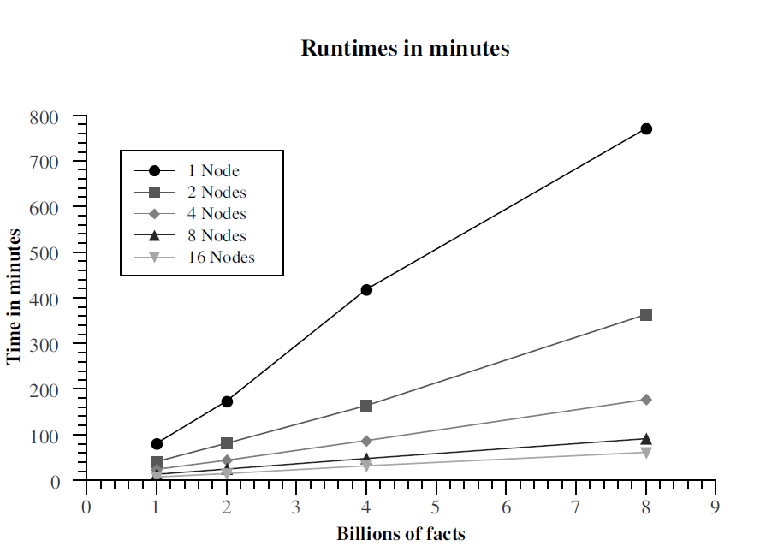
KR 2012 – Results (1/2)
Ranging the number of facts from 1 to 8 billions
Using 1 to 16 nodes
Linear performance

Slide 24
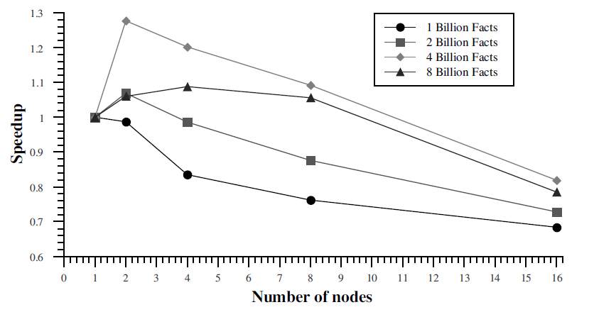
KR 2012 – Results (2/2)
Scaled speedup (speedup per node)
Ranging the number of facts from 1 to 8 billions
Using 1 to 16 nodes
Performance
Superlinear due to large RAM
Sublinear is generally expected

Slide 25
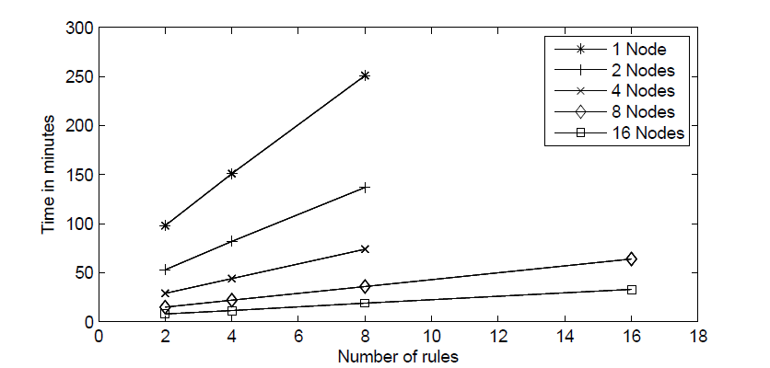
ECAI 2012 – Results (1/2)
Ranging the number of rules from 2 to 16
Using 1 to 16 nodes
Linear performance

Slide 26
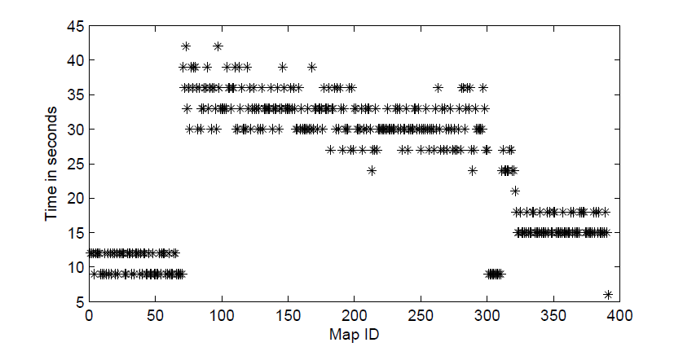
ECAI 2012 – Results (2/2)
Map time during the second pass
Good load-balancing properties

Slide 27
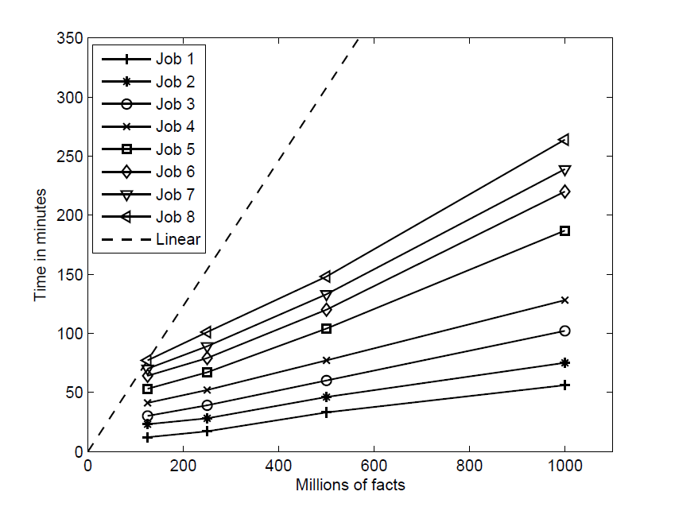
ISWC SSWS+HPCSW 2012 (1/3)
Ranging the number of facts from 125 millions to 1 billion
Using 40 cores
Sublinear performance

Slide 28
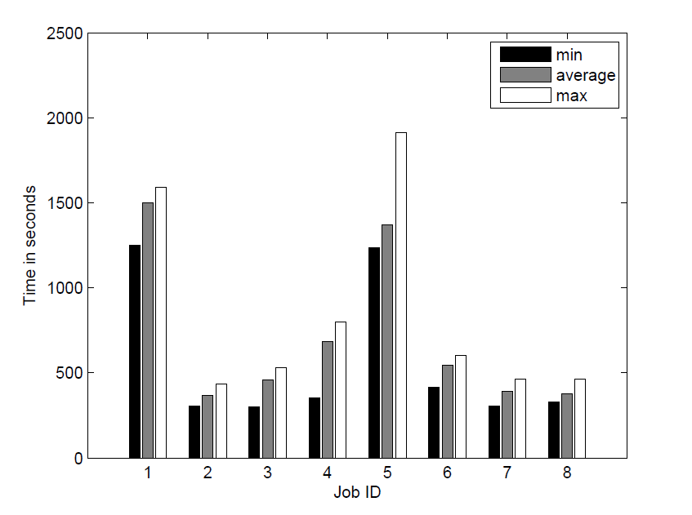
ISWC SSWS+HPCSW 2012 (2/3)
Input of 1 billion facts
Using 40 cores
40 Reduce tasks
Minimum, average and maximum reduce task runtime for each job indicate good load balance properties

Slide 29
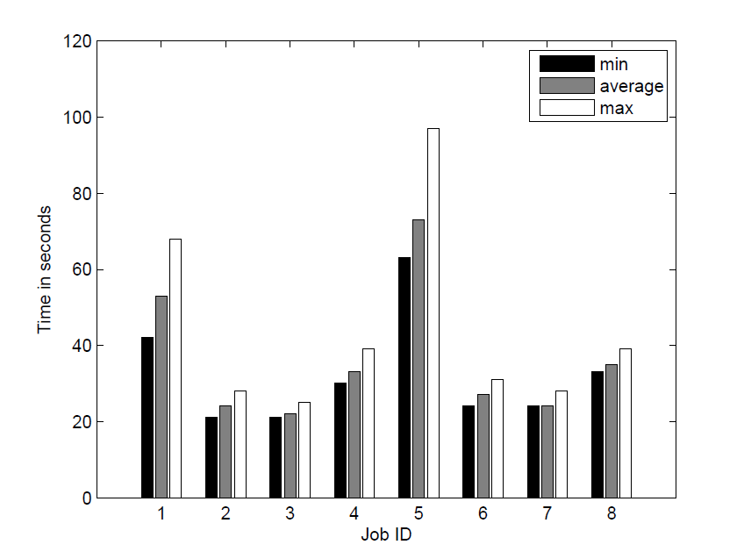
ISWC SSWS+HPCSW 2012 (3/3)
Input of 1 billion facts
Using 40 cores
400 Reduce tasks
Minimum, average and maximum reduce task runtime for each job indicate good load balance properties

Slide 30
Well-Founded Semantics (1/6)
Each program has one well-founded model
Three-valued Herbrand model

Slide 31
Well-Founded Semantics (2/6)
Herbrand base
Non-false atoms
true
undefined
false
True atoms

Slide 32
Well-Founded Semantics (3/6)
Alternating Fixpoint Procedure is applicable to MapReduce
Computing and storing true and undefined literals is feasible for Big Data

Slide 33
Well-Founded Semantics (4/6)
Monotonicity formally
K_{i} ⊆ K_{i+1}, U_{i} ⊇ U_{i+1}, K_{i} ⊆ U_{i}
Monotonicity visually
K_{i}
K_{i+1}
U_{i+1}
U_{i}
K_{i}
U_{i}

Slide 34
Well-Founded Semantics (5/6)
Inference procedure visually
K₀
U₀
K₁
U₁
K₂
U₂
K₃
U₃
(K₂,U₂)=(K₃,U₃) Fixpoint!

Slide 35
Well-Founded Semantics (6/6)
WFS fixpoint reached at step i:
true literals, denoted by K_{i}
undefined literals, denoted by U_{i} - K_{i}
false literals, BASE(P) - U_{i}

Slide 36
T_{P,J}(I) calculation (1/5)
T_{P,J} (I) models both “join” and “anti-join” operations from database
Example:
I ={parent(John, Alice), parent(John, Jill), sibling(Alice, Edward), sibling(Jill, Mary)}
J = {female(Mary)}
and a program P:
son(X,Y) ← parent(Y,Z), sibling(Z,X), not female(X)
parentOfSiblings(Y,X,Z)
son(X,Y)
Join
Anti-join

Slide 37
T_{P,J}(I) calculation (2/5): “Join”
INPUT
Facts in multiple files
MAP phase Input
Key: position in file (ignored)
Value: fact
File containing set I
----------
parent(John, Alice)
parent(John, Jill)
sibling(Alice, Edward)
sibling(Jill, Mary)
<key, parent(John, Alice) >
<key, parent(John, Jill)>
< key, sibling(Alice, Edward)>
File containing set J
----------
female(Mary)
<key, sibling(Jill, Mary)>
<key, female(Mary)>

Slide 38
T_{P,J}(I) calculation (3/5): “Join”
MAP phase Output
Reduce phase Input
<Alice, (parent, John)>
<Alice, <(parent, John), (sibling, Edward)>>
< Jill, (parent, John)>
Grouping/Sorting
<Alice, (sibling, Edward)>
<Jill, <(parent, John),
(sibling, Mary)>>
<Jill, (sibling, Mary)>

Slide 39
T_{P,J}(I) calculation (4/5): “Join”
Reduce phase Input
Reduce phase Output Output: new conclusion
<Alice, <(parent, John),
(sibling, Edward)>>
parentOfSiblings(John, Edward, Alice)
<Jill, <(parent, John),
(sibling, Mary)>>
parentOfSiblings(John, Mary, Jill)

Slide 40
T_{P,J}(I) calculation (5/5)
Rule:
son(X,Y) ← parent(Y,Z), sibling(Z,X), not female(X)
Join
parentOfSiblings(Y,X,Z)
female(Mary)
parentOfSiblings(John, Edward, Alice)
parentOfSiblings(John, Mary, Jill)
Anti-join
son(Edward, John)

Slide 41
Optimized WFS fixpoint
WFS fixpoint(P):
// input: program P,
// output: set of literals K_{i-1}, U_{i-1}
K₀ = lfp(P+, ∅, ∅);
i = 0;
do
U_{i} = K_{i} ∪ lfp(P, K_{i}, K_{i});
i++; // next “inference step”
K_{i} = K_{i-1} ∪ lfp(P, K_{i-1}, U_{i-1});
while (K_{i-1}.size() != K_{i}.size())
return K_{i-1}, U_{i-1};
Need to store
K_{i} ⊆ U_{i}
K_{i-1} ⊆ K_{i}
If K_{i-1} = K_{i} then
U_{i-1} = K_{i-1} ∪ lfp(P, K_{i-1}, K_{i-1})
= K_{i} ∪ lfp(P, K_{i}, K_{i}) = U_{i}

Slide 42
Optimized least fixpoint of T_{P,J} (I)
lfp(P, I, J):
// input: program P, set of literals I, J
// output: set of literals S (least fixpoint)
S = ∅;
new = ∅;
do
S = S ∪ new;
new = T(P, (I ∪ S), J); // rule set application
new = new - (I ∪ S); // duplicate elimination
while(new != ∅)
return S;
Infer new literals preserving
I ∩ S = ∅

Slide 43
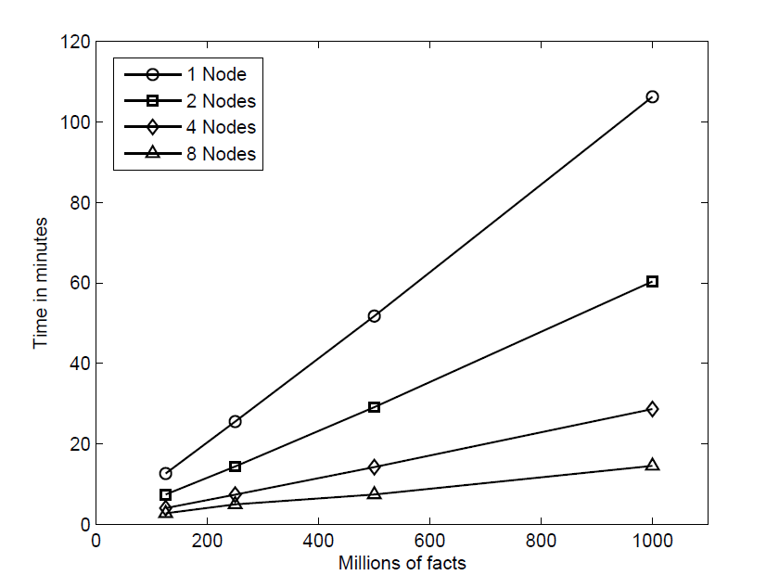
RuleML 2013 (1/2)
Ranging the number of facts from 125 millions to 1 billion
Using 1 to 8 nodes
Linear performance

Slide 44
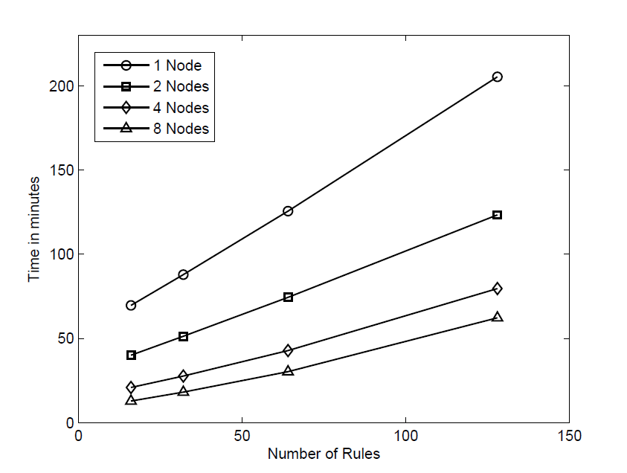
RuleML 2013 (2/2)
Ranging the number of rules from 16 to 128
Using 1 to 8 nodes
Linear performance for up to 64 rules

Slide 45
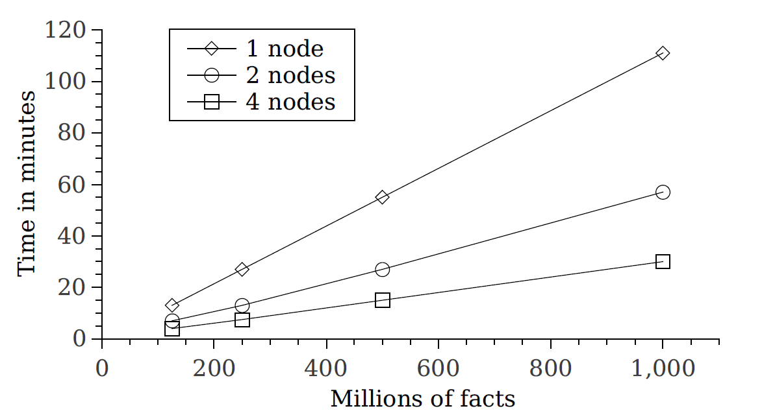
ICLP 2014 (1/4)
Win-not-win test (cycle)
Ranging the number of facts from 125 millions to 1 billion
Using 1 to 4 nodes
Linear performance

Slide 46
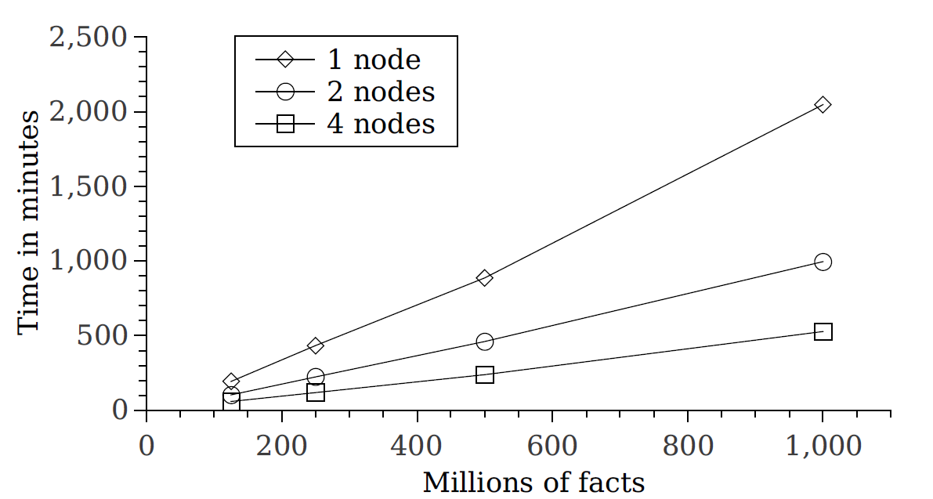
ICLP 2014 (2/4)
Win-not-win test (tree-structured)
Ranging the number of facts from 125 millions to 1 billion
Using 1 to 4 nodes
Linear performance

Slide 47
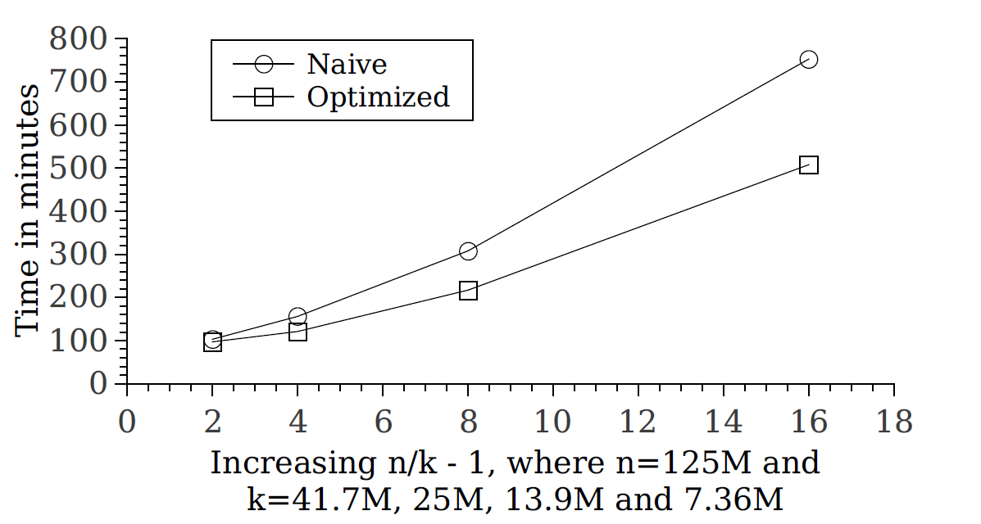
ICLP 2014 (3/4)
Naïve vs Optimized increasing chain lengths
Using 7 nodes
Optimized implementation works better for long chain (high percentages of pre-computed literals)

Slide 48
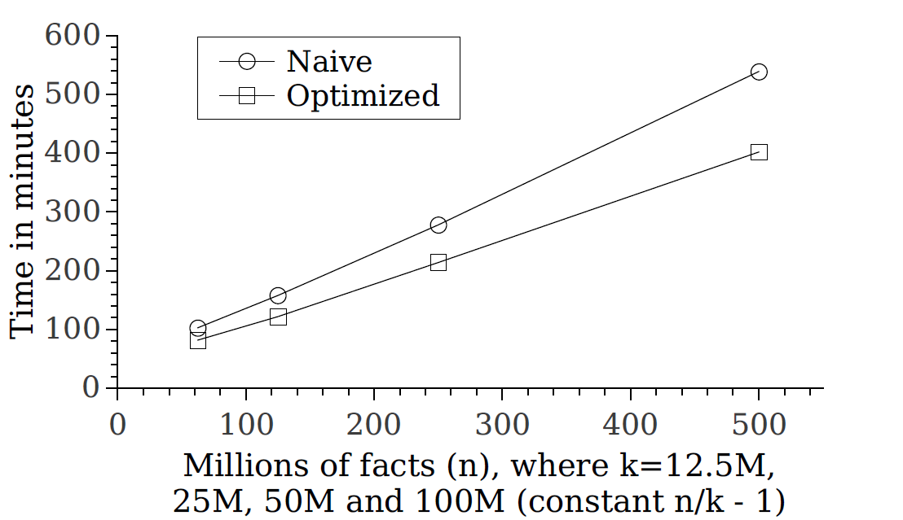
ICLP 2014 (4/4)
Naïve vs Optimized constant chain lengths
Using 7 nodes
Optimized implementation has constant speedup for increasing data (constant percentages of pre-computed literals)

Slide 49
Summary
Computed the Stratified Defeasible Logic over Big Data
Computed the Well-Founded Semantics over Big Data
Demonstrated that reasoning can scale well up to 1 billion facts

Slide 50
Future Work
Experimental Evaluation
Extensive evaluation our approach for WFS
Query answering over WFS
Reasoning beyond MapReduce
Study more complex NMR approaches including ontology evolution/repair and Answer-Set Programming

Slide 51

Thank you!

